Slide 1


PREDICTION OF STUDENT PERFORMANCE ANALYSIS
BY
171FA04147
171FA04181
171FA04204

Slide 2
Abstract:
Over the years, several statistical tools have been used to analyze and predict students’ performance from different point of view.
One of the biggest challenges for higher education ,Today is to predict the paths of students through the educational process.
Successful students result prediction in early course stage depends on many factors. Data mining techniques could be used for this kind of job.
Data mining techniques are widely used in educational field to find new hidden patterns from student’s data. The hidden patterns that are discovered can be used to understand the problem arise in the educational field. Data Mining (DM), or Knowledge Discovery in Databases (KDD), is an approach to discover useful information from large amount of data.

Slide 3
Introduction:
Nowadays, data mining is playing a vital role in educational institutions and one of the most important areas of research with the objective of finding meaningful information from the data stored in huge dataset.
Educational data mining (EDM) is a very important research area which helpful to predict useful information from educational database to improve educational performance, better understanding and to have better assessment of the students learning process.
Data Mining or knowledge discovery has become the area of growing significance because it helps in analyzing data from different perspectives and summarizing it into useful information.

Slide 4
Problem Definition:
Data mining is widely used in educational field to find the problems arise in this field. Student performance is of great concern in the educational institutes where several factors may affect the performance.
For prediction the three required components are: Parameters which affect the student performance, Data mining methods and third one is data mining tool. These Parameters may be psychological, personal, and environmental. We conduct this study to maintain the education quality of institute by minimizing the diverse affect of these factors on student’s performance.

Slide 5
Modules:
Module 1:
Create a dataset which is used for our system.
Module 2:
Read the CSV file with pandas:
The pandas library is very useful when we need to perform various operations on data files like csv. pd.read_csv() reads the CSV file and loads it into the pandas DataFrame.
Module 3:
From our dataset take some part of data as our training set data and train the model using clustering.
In this we use Classification , these models are derived by analysing historical or previous data . we need to train the model or finding a model to classify unknown data.
In our project we use KDD algorithm( Knowledge Discovery in Databases).

Slide 6
Modules:
Module 4:
We need to test the model with the remaining data in the dataset.
Module 5:
display the output using visualization of scatter plots for better understanding.

Slide 7
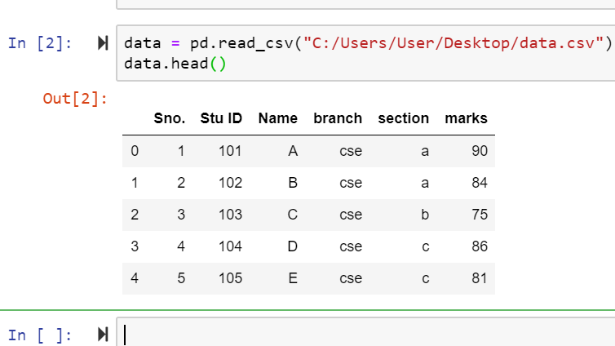
Creation Of Dataset:

Slide 8


